Slide 1
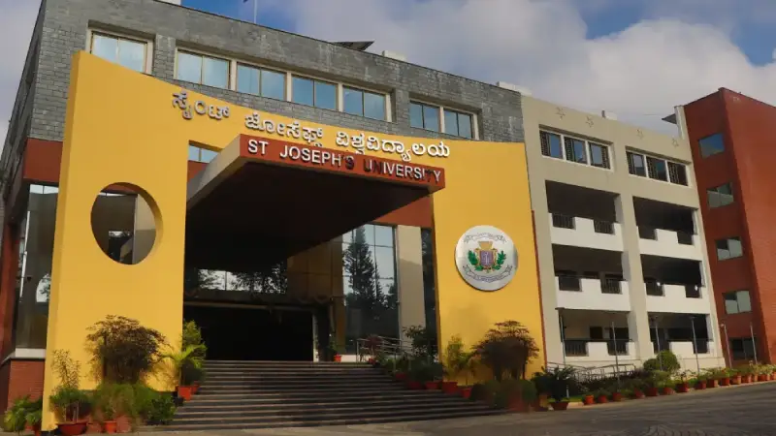

Drug-Likeness Prediction Using Artificial Neural Network
Name of the Student: ARJUN V
Register Number: 221BCADA36

Slide 2

Contents
Abstract
Introduction
Literature Survey
Problem Definition
Proposed Work
Methodology & Implementation
Results & Discussions
Conclusion
Reference

Slide 3
Abstract
This project presents a web-based application for predicting the drug-likeness of molecules based on SMILES (Simplified Molecular Input Line Entry System) strings using a fine-tuned BERT model (bert-base-uncased). The tool classifies molecules as drug-like or non-drug-like and also provides a probability score, 2D structure visualization, and a 3D molecular viewer using Py3Dmol. The application enables researchers and students to quickly assess molecules without needing expert cheminformatics knowledge.

Slide 4
Introduction
Drug discovery is a long, expensive process. Machine learning, especially neural networks, provides a powerful way to predict drug-likeness based on compound properties. This project uses molecular descriptors to train a model that predicts whether a compound is likely to be a drug. This work bridges chemistry and AI, contributing to faster and cost-effective drug screening.

Slide 5
Literature Survey
Multiple studies have used ML algorithms for predicting molecular activity.
Techniques like Random Forests, SVM, and Gradient Boosting have shown success.
Deep learning, especially ANNs and Graph Neural Networks, is proving more powerful for chemical structure-based predictions.
QED (Quantitative Estimate of Drug-likeness) and logP are standard metrics used in many published works.

Slide 6
Literature Survey
S.No | Title / Tool | Author(s) | Year | Conclusion / Findings
1 | Rule of Five (Ro5) | Christopher A. Lipinski | 1997 | Proposed rules for drug-likeness based on molecular properties (e.g., MW < 500, logP < 5).
2 | DeepChem | Bharath Ramsundar et al. | 2017 | Provides tools for deep learning in drug discovery, supports SMILES and molecular graphs.
3 | ChemBERTa: Transformer-based Model for Molecules | Morgan et al. (Facebook AI) | 2021 | Applied BERT-style models on SMILES, significantly improving QSAR and drug-likeness tasks.
4 | SMILES Transformer | Honda et al. | 2019 | Used transformer encoder-decoder model to learn chemical representations from SMILES.
5 | DrugEx: Reinforcement Learning for Drug Discovery | Liu et al. | 2019 | Combines SMILES-based representations with RL to generate drug-like molecules.
6 | RDKit | Greg Landrum (Open Source Toolkit) | Ongoing | Enables 2D/3D visualization, molecular analysis, and descriptor calculation.
7 | BERT: Pre-training of Deep Bidirectional Transformers | Jacob Devlin et al. (Google AI) | 2018 | Introduced the foundational BERT model used for SMILES tokenization in our project.

Slide 7
Problem Definition
Manual screening of compounds is time-consuming and often inaccurate.
Lack of lightweight web tools using modern NLP transformers.
Problem: Predict drug-likeness of a compound using SMILES and visualize it interactively.

Slide 8
Proposed Work
The project proposes a deep learning model for predicting drug-likeness using SMILES representations of molecules.
Instead of using a transformer-based architecture like BERT, a custom hybrid model was designed.
The model combines:
1D Convolutional Layer: For local feature extraction from SMILES embeddings.
Bidirectional LSTM: To capture contextual information from both past and future sequences.
LSTM Layer: For sequential learning of molecular structure.
Dense Layers: For final binary classification.
This architecture allows the model to efficiently learn structural patterns in chemical compounds.

Slide 9
Methodology & Implementation
Data: 250K SMILES from ZINC database.
Preprocessing: Tokenization of SMILES, label assignment.
Model: hybrid of CNN + BiLSTM + LSTM
Deployment:
Frontend: HTML + JS.
Backend: Flask with Python.
2D structures: RDKit.
3D viewer: Py3Dmol + MOL block conversion.

Slide 10
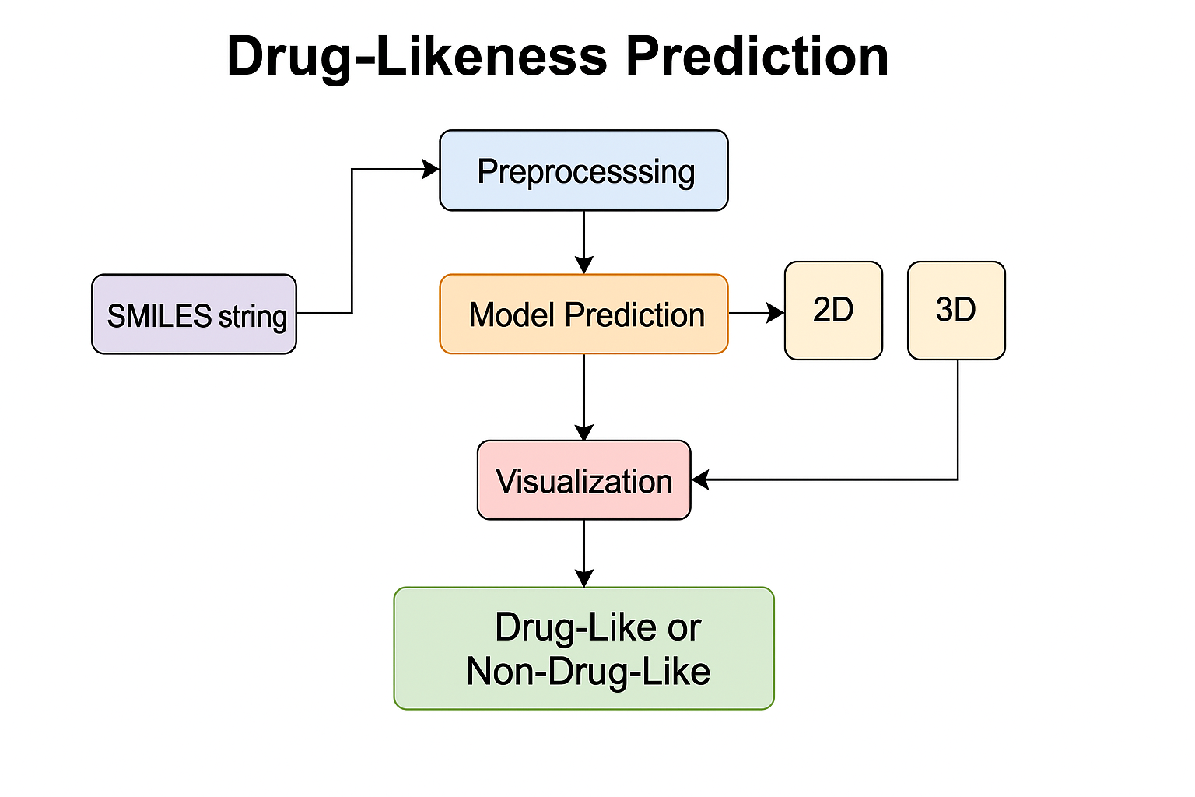
Methodology & Implementation

Slide 11
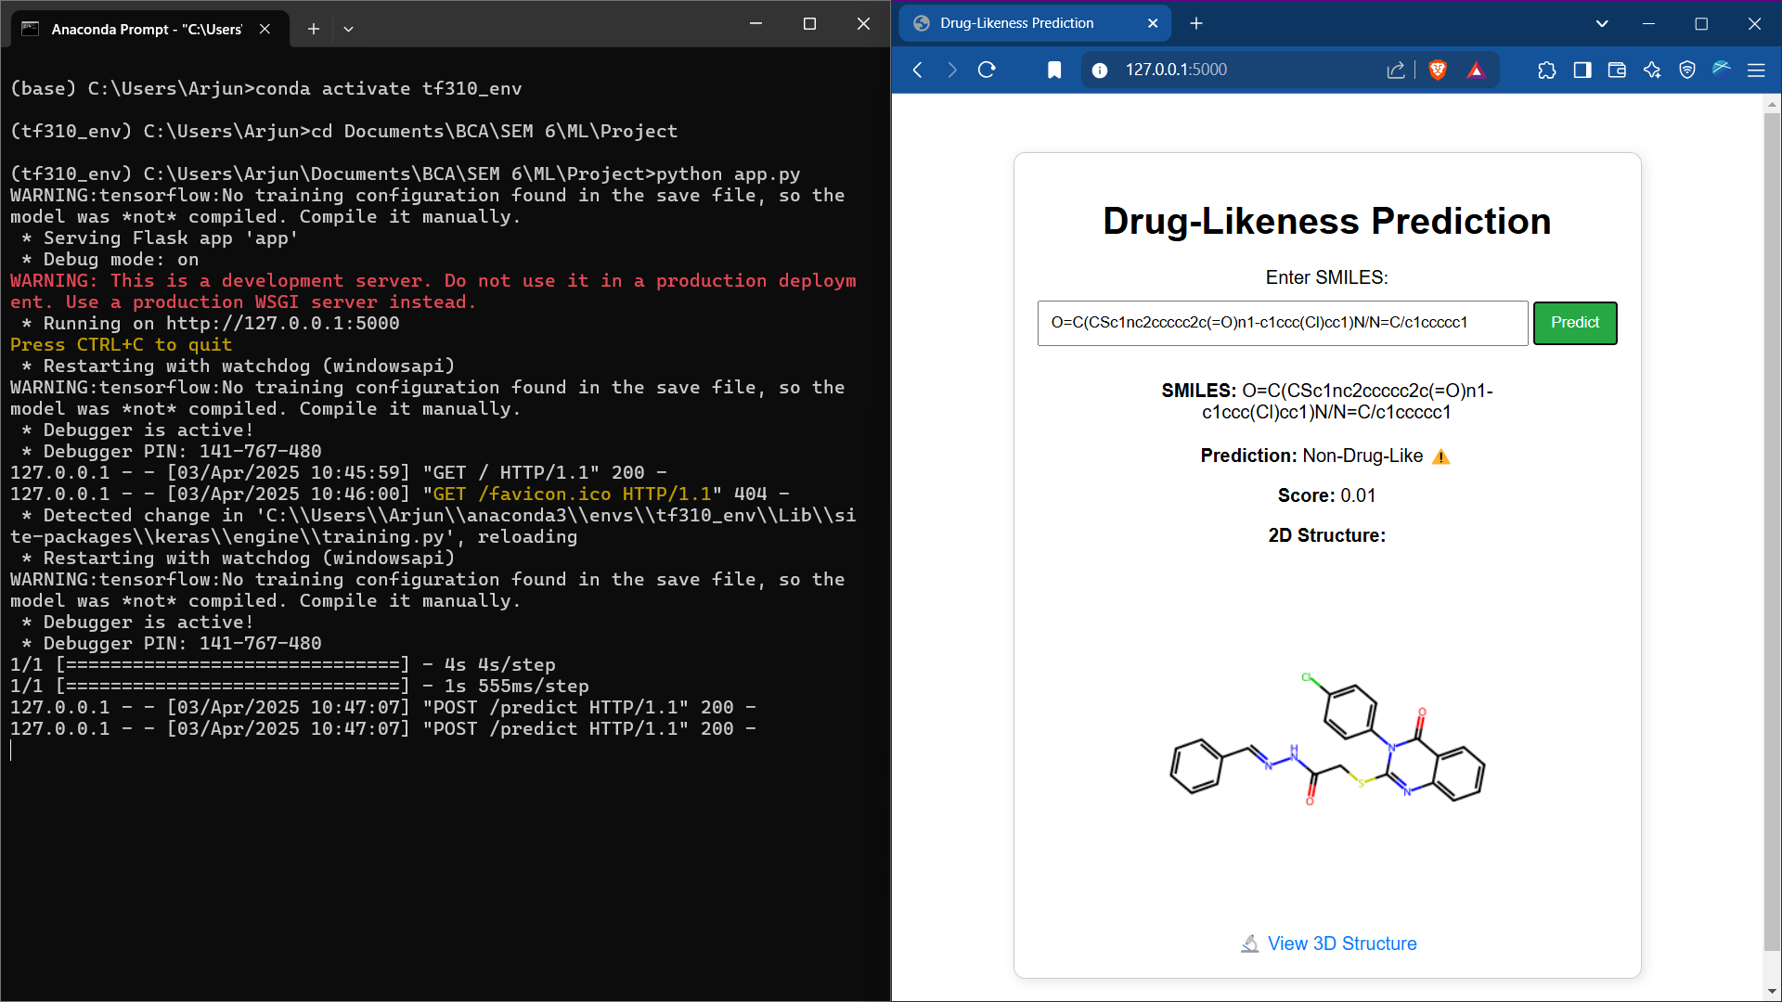
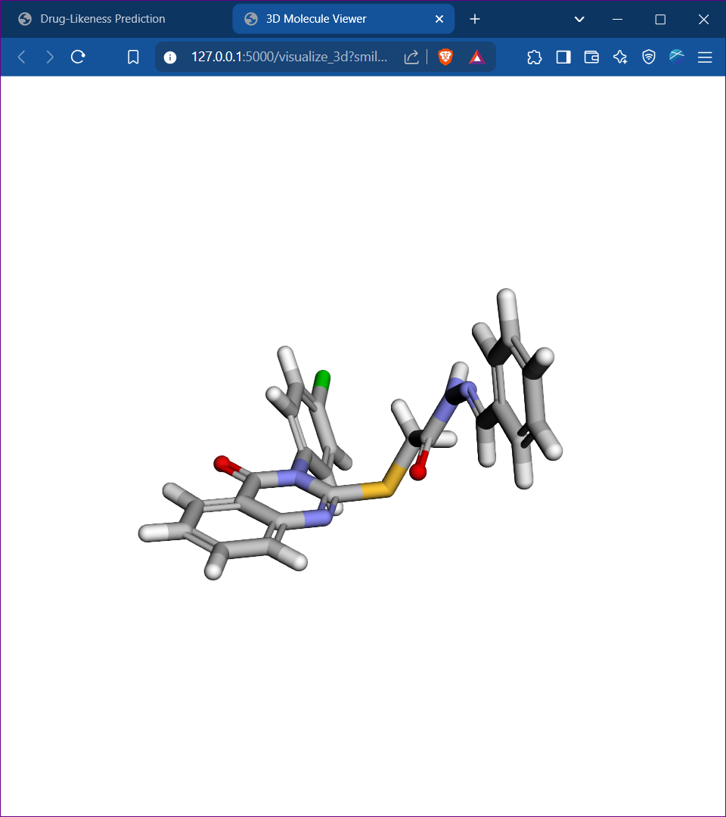
Methodology & Implementation

Slide 12
Results & Discussions
Model achieved an accuracy of ~85% and ROC-AUC of ~0.89.
Observations:
logP and SAS were more discriminative than QED alone.
Outliers in logP had minimal effect post-normalization.

Slide 13
Conclusion
Developed an end-to-end solution for drug-likeness prediction.
Integrated visualization components enhance user interactivity.
Accessible through web interface—no installations needed.
Future work:
Add support for multi-class properties (toxicity, permeability).
Improve accuracy using domain-specific embeddings (e.g., ChemBERTa).
Optimize inference time and UI enhancements.

Slide 14
Reference
HuggingFace Transformers
RDKit documentation
Py3Dmol visualization library
Research articles on BERT for molecular representations
ZINC Database

Slide 15
Thank You

